Slide 1

Database Systems and Web (15B11CI312)

Slide 2
Contents to be covered
JOIN
Cartesian Products
Inner Joins (Equijoins)
Self Joins
Outer Joins (Left, Right and Full)

Slide 3
JOIN
An SQL join clause combines records from two or more tables in a database.
It creates a set that can be saved as a table or used as it is.
A JOIN is a means for combining fields from two tables by using values common to each (in most of the cases by using foreign key).
A programmer writes a JOIN statement to identify the records for joining. If the evaluated predicate is true, the combined record is then produced in the expected format, a record set or a temporary table.

Slide 4
Types of JOINS in a table
(SQL) Joins can be classified into the following categories :
Cartesian Products
Inner Joins (Equijoins)
Self Joins
Outer Joins (Left, Right and Full)

Slide 5
Different SQL Joins
JOIN: Return rows when there is at least one match in both tables
LEFT JOIN: Return all rows from the left table, even if there are no matches in the right table
RIGHT JOIN: Return all rows from the right table, even if there are no matches in the left table
FULL JOIN: Return rows when there is a match in one of the tables

Slide 6
Cartesian Products (Cross Join)
The Cartesian-product operation, denoted by a cross (×), allows us to combine information from any two relations.
We write the Cartesian product of relations r1 and r2 as r1 × r2.
Join without a Join Condition
It is the base of all the other types of join.
In other words, it will produce rows which combine each row from the first table with each row from the second table.
Source: Fundamentals of database systems / Ramez Elmasri, Shamkant B. Navathe.—7th ed, Pearson Publications
Notes:
If a join is performed without a Join Condition then the Cartesian product of the specified tables is returned.
Cartesian products can generate many rows of (meaningless?) data, for this reason they are often used for creating test data. Apart from this, they have few practical uses.
Cartesian products form the base of all the other types of join.

Slide 7
Example:
SELECT * FROM
Employee CROSS JOIN Project;
Employee (20 rows)
SSN Name
123 John
124 Mary
125 Mark
126 Jane
Project (8 rows)
SSN Code
123 DBS
124 PRG
124 DBS
126 PRG
SSN Name SSN Code
123 John 123 DBS
124 Mary 123 DBS
125 Mark 123 DBS
126 Jane 123 DBS
123 John 124 PRG
124 Mary 124 PRG
125 Mark 124 PRG
126 Jane 124 PRG
123 John 124 DBS
124 Mary 124 DBS
Cartesian product: 20 x 8 = 160 rows
..…
..…
8 rows selected
..…

Slide 8
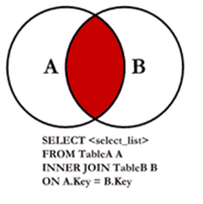
INNER JOIN
An 'inner join' is the most common join operation used in applications and can be regarded as the default join-type.
Inner join creates a new result table by combining column values of two tables (A and B) based upon the join-predicate.
The result of the join can be defined as the outcome of first taking the Cartesian product (or Cross join) of all records in the tables (combining every record in table A with every record in table B) and then returning all records which satisfy the join predicate.

Slide 9
Inner join Cont.
The two tables must be joined by at least one common field. That is, the join field is a member of both tables.
Syntax:
Select * from A, B where A.x = B.y The column names (x and y in this example) are often, but not necessarily, the same.
Example:
SELECT EmployeeName, DeptName FROM Employee INNER JOIN Department ON Employee.DeptID = Department.DeptID;

Slide 10
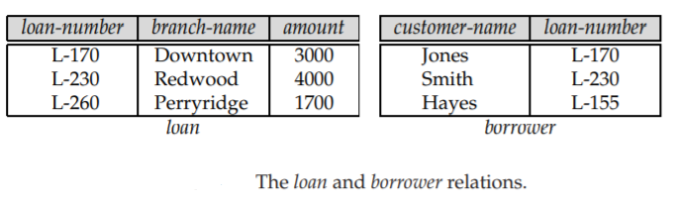
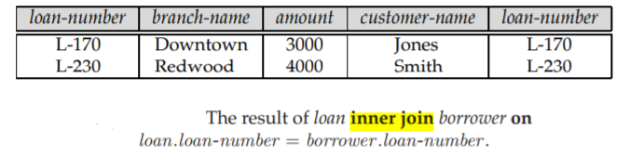
Source: Database System Concepts / Silberschatz−Korth−Sudarshan

Slide 11
Notations
1. The "explicit join notation" uses the JOIN keyword, optionally preceded by the INNER keyword, to specify the table to join, and the ON keyword to specify the predicates for the join:
SELECT * FROM employee INNER JOIN department ON
employee.DepartmentID = department.DepartmentID;
2. The "implicit join notation" simply lists the tables for joining without using JOIN keyword.
SELECT * FROM employee, department WHERE
employee.DepartmentID = department.DepartmentID;

Slide 12
Join Clauses
Using (A1,A2,A3…An) where A1,A2,….An are attributes
ON(Predicate)

Slide 13
Creating Joins with the Using Clause
Student
ID Name
123 John
124 Mary
125 Mark
126 Jane
SELECT * FROM
Student INNER JOIN Enrolment USING (ID)
ID Name ID Code
123 John 123 DBS
124 Mary 124 PRG
124 Mary 124 DBS
126 Jane 126 PRG
Enrolment
ID Code
123 DBS
124 PRG
124 DBS
126 PRG

Slide 14
Creating Joins with the ON Clause
Use the ON clause to specify arbitrary conditions or specify columns to join.
The join condition is separated from other search conditions.
The ON clause makes code easy to understand.
Notes:
ON Clause
Use the ON clause to specify a join condition. This lets you specify join conditions separate from any search or filter conditions in the WHERE clause.

Slide 15
Example with on clause:
Buyer
Name Budget
Smith 100,000
Jones 150,000
Green 80,000
SELECT * FROM Buyer as B INNER JOIN Property as P
ON P.Price <= B.Budget
Property
Address Price
15 High St 85,000
12 Queen St 125,000
87 Oak Row 175,000
Name Budget Address Price
Smith 100,000 15 High St 85,000
Jones 150,000 15 High St 85,000
Jones 150,000 12 Queen St 125,000

Slide 16
USING | ON
SELECT * FROM A INNER JOIN B USING(col1, col2,...) is the same as SELECT * FROM A, B WHERE A.col1 = B.col1 AND A.col2 = B.col2 AND ... | SELECT * FROM A INNER JOIN B ON <condition> is the same as SELECT * FROM A, B WHERE <condition>

Slide 17
Equijoins
An Equi-join is a specific type of comparator-based join, that uses only equality comparisons in the join-predicate.
Using other comparison operators (such as <) disqualifies a join as an Equi-join.
The order of the tables listed in the FROM clause should have no significance.

Slide 18
Natural join
A natural join is a type of Equi-join that only work if the column you are joining by has same name in both tables.
The resulting joined table contains only one column for each pair of equally named columns.

Slide 19
NATURAL JOIN
SELECT * FROM
Employee NATURAL JOIN Project;
EMPLOYEE
SSN Name
123 John
124 Mary
125 Mark
126 Jane
PROJECT
SSN Code
123 DBS
124 PRG
124 DBS
126 PRG
SSN | NAME | CODE
123 | John | DBS
124 | Mary | PRG
124 | Mary | DBS
126 | Jane | PRG
The join condition for the natural join is basically an equijoin of all columns with the same name.

Slide 20
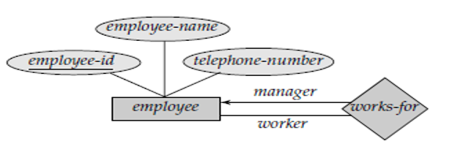
Self Join
A Self Join is a join of a table to itself.
Put the table in the FROM clause twice.
Use aliases to distinguish columns in the WHERE clause.
Syntax:
SELECT a.column_name, b.column_name
FROM table1 a, table1 b
WHERE a.common_filed = b.common_field;

Slide 21
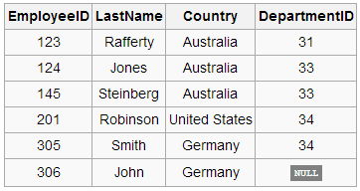
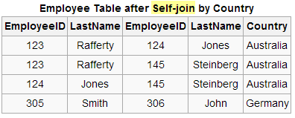
A query to find all pairings of two employees in the same country is desired.
SELECT e1.EmployeeID, e1.LastName, e2.EmployeeID, e2.LastName, e2.Country
FROM Employee As e1, Employee As e2 WHERE e1.Country = e2.Country;
Can also write like
this: without writing As
Employee e1, Employee e2

Slide 22
Outer Join
An Inner Join excludes rows from either table that don't have a matching row in the other table.
An Outer Join allows us to return unmatched rows.
Outer Joins come in three varieties :
LEFT ( MATCHED ROWS IN RIGHT TABLE AND ALL ROWS IN LEFT TABLE )
RIGHT ( MATCHED ROWS IN LEFT TABLE AND ALL ROWS IN RIGHT TABLE )
FULL ( ALL ROWS IN ALL TABLES IT DOESN'T MATTERS EVEN MATCH IS THERE OR NOT )

Slide 23
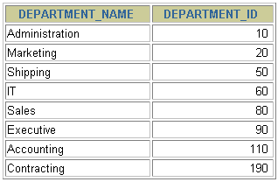
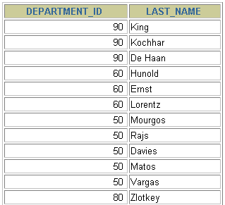
Outer Joins
Copyright © 2007, Oracle. All rights reserved
DEPARTMENTS
EMPLOYEES
…
There are no employees in department 190.
Returning Records with No Direct Match with Outer Joins
If a row does not satisfy a join condition, the row does not appear in the query result. For example, in the equijoin condition of EMPLOYEES and DEPARTMENTS tables, department ID 190 does not appear because there are no employees with that department ID recorded in the EMPLOYEES table. Instead of seeing 20 employees in the result set, you see 19 records.
To return the department record that does not have any employees, you can use an outer join.

Slide 24
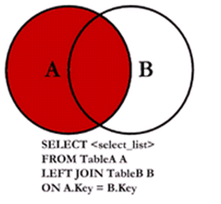

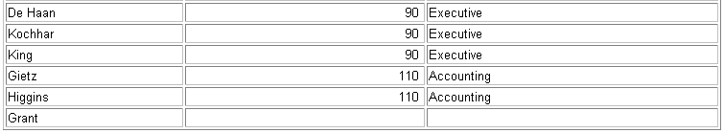
LEFT OUTER JOIN
Copyright © 2007, Oracle. All rights reserved
A left outer join will give all rows in A, plus any common rows in B
SELECT e.last_name, e.department_id, d.department_name
FROM employees e LEFT OUTER JOIN departments d
ON (e.department_id = d.department_id) ;
…
This query retrieves all rows in the EMPLOYEES table, which is the left table even if there is no match in the DEPARTMENTS table.

Slide 25
LEFT OUTER JOIN
Copyright © 2007, Oracle. All rights reserved
A left outer join will give all rows in A, plus any common rows in B
SELECT e.last_name, e.department_id, d.department_name
FROM employees e RIGHT OUTER JOIN departments d
ON (e.department_id = d.department_id) ;
…
This query retrieves all rows in the EMPLOYEES table, which is the left table even if there is no match in the DEPARTMENTS table.

Slide 26
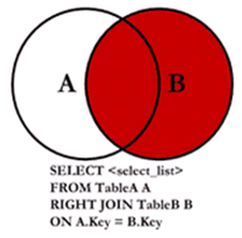
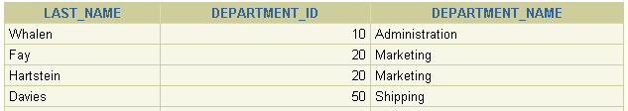
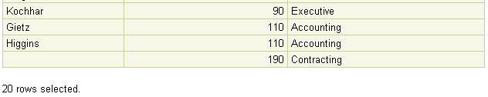
RIGHT OUTER JOIN
Copyright © 2007, Oracle. All rights reserved
SELECT e.last_name, d.department_id, d.department_name
FROM employees e RIGHT OUTER JOIN departments d
ON (e.department_id = d.department_id) ;
…
This query retrieves all rows in the DEPARTMENTS table, which is the right table even if there is no match in the EMPLOYEES table.

Slide 27
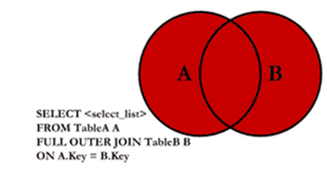
FULL OUTER JOIN
The joined table will contain all records from both the tables and fill in NULLs for missing matches on either side

